Slide 1


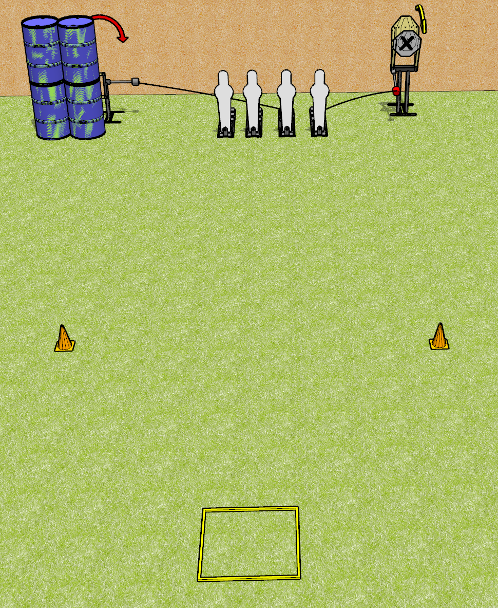
 | Dothan Gun Club – USPSA Match Yeet Course Designer : Drew Coleman
Round Count 8 rounds 2 IPSC 4 Pepper poppers
Equipment List Shooting box 2 cones Swinger + activator Max trap + activator

Slide 2
Yeet
Written Stage Briefing
Yeet is an 8 round, 40 point, Comstock speed shoot. There are 2 IPSC targets and 4 pepper poppers. The best 2 hits on paper will score, and steel must fall to score. The start signal is audible.
The swinger is activated by the left 2 pepper poppers. The max trap is activated by the right 2 pepper poppers. The swinger and the max trap are visible at rest and must be activated before being engaged. Please check the activators prior to walkthrough and set them the same way every time.
Handgun start position is in shooting box facing uprange, wrists above shoulders. Handgun is loaded and holstered.
PCC start position is in shooting box, muzzle pointed at either orange cone. Loaded carbine is held with both hands, safety on.
On start signal, engage targets as they become available from within the shooting area.

Slide 3
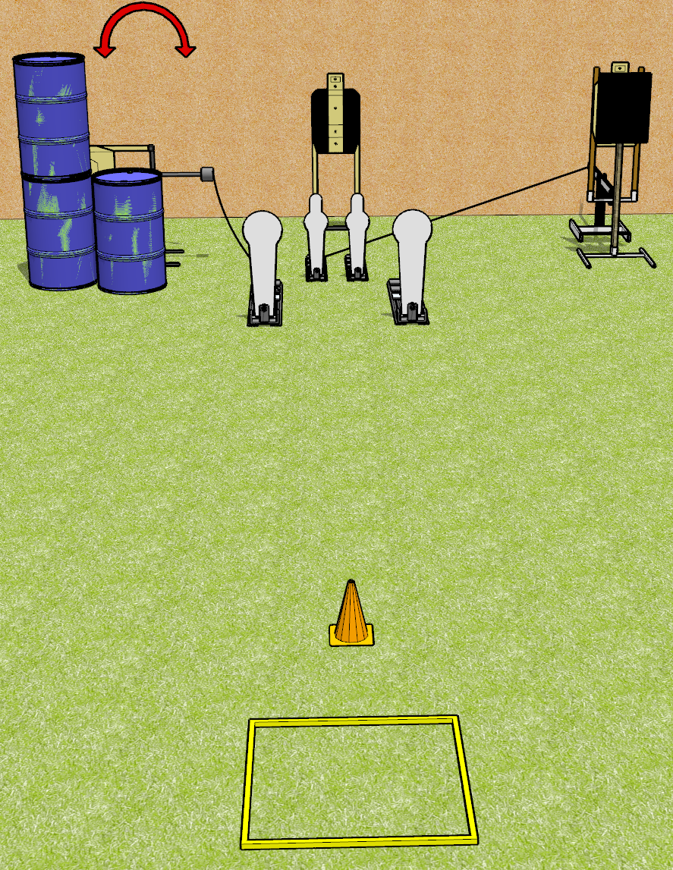
 | Dothan Gun Club – USPSA Match Now That’s Spicy Course Designer : Drew Coleman
Round Count 13 rounds 3 USPSA targets 2 colt poppers, 2 mini poppers
Equipment List Shooting box Swinger + activator Bobber + activator + steel 18x24 plate and stand 1 tuxedo

Slide 4
Now That’s Spicy
Written Stage Briefing
Now That’s Spicy is a 13 round, 65 point, Comstock speed shoot. There are 3 USPSA targets, 2 colt poppers, and 2 mini poppers. The best 3 hits on paper will score, and steel must fall to score. The start signal is audible.
The bobber is activated by either mini popper. The swinger is activated by the left colt popper. Please check the activators prior to walkthrough and set them the same way every time.
Handgun start position is in the shooting box, wrists below belt. Handgun is loaded and holstered.
PCC start position is in the shooting box, muzzle pointed at cone. Loaded carbine is held with both hands, safety on.
On start signal, engage any 2 poppers, perform a mandatory reload, and engage the remaining poppers. The paper targets may be engaged at any time in any order. Engaging more than 2 poppers without reloading will be a single procedural per popper engaged.

Slide 5
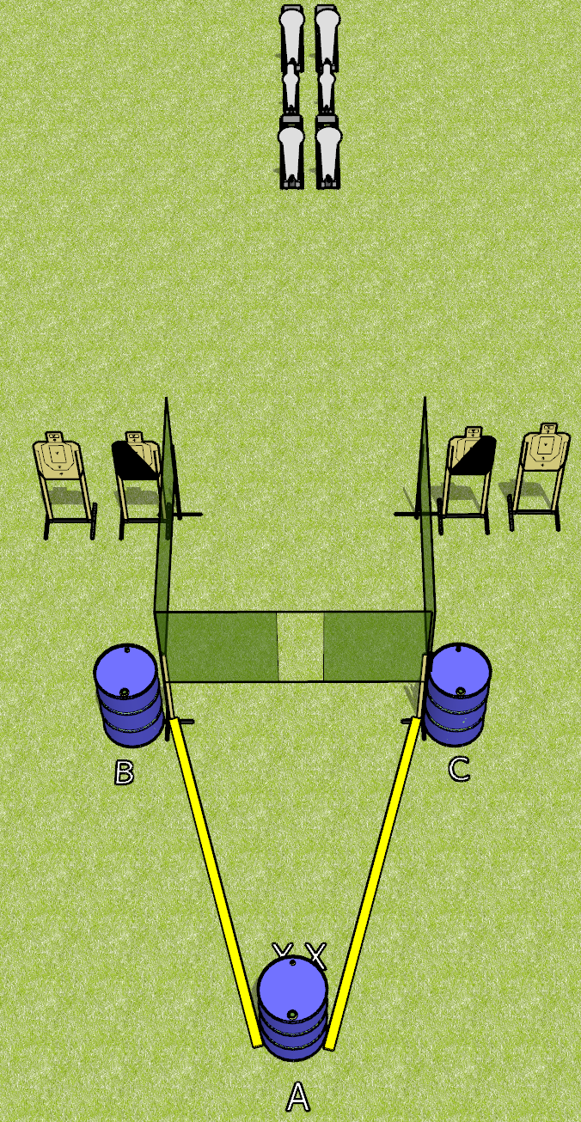
 | Dothan Gun Club – USPSA Match Borrowed from Jake Course Designer : Jake Martens
Round Count 14 rounds 4 USPSA targets 4 colt poppers, 2 mini poppers
Equipment List 4 wall feet 1 left and 1 diagonal hard cover

Slide 6
Borrowed from Jake
Written Stage Briefing
Borrowed from Jake is a 14 round, 70 point, Comstock medium course. There are 4 USPSA targets, 4 colt poppers, and 2 mini poppers. The best 2 hits on paper will score, and steel must fall to score. The start signal is audible.
Start position is toes touching X’s, facing uprange, both hands touching top surface of uprange barrel (A).
Firearm is placed on either down range barrel (B or C), unloaded and unpropped. All magazines to be used on the stage must be placed on any barrel(s) WITHOUT the firearm.
On start signal, engage targets as they become available from within the fault lines.

Slide 7
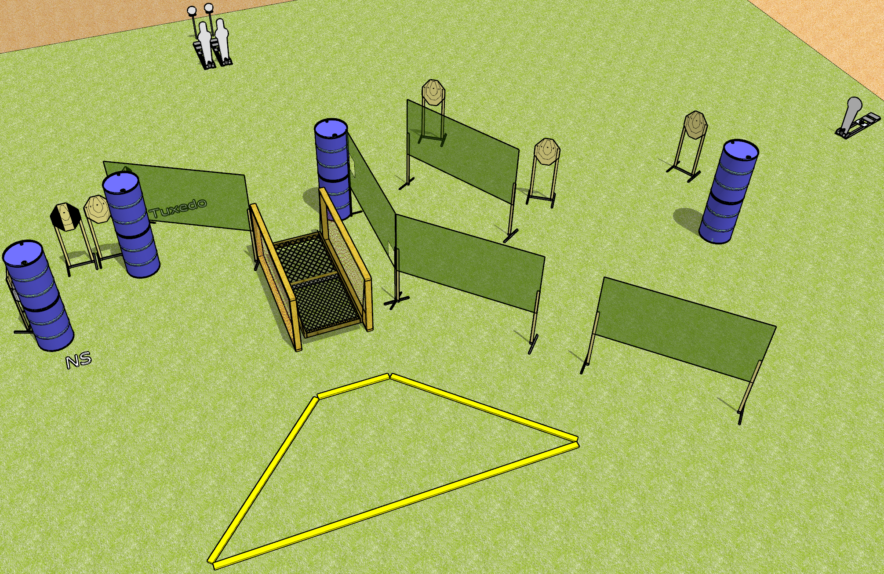
 | Dothan Gun Club – USPSA Match Wobbly Knees Course Designer : Drew Coleman
Round Count 19 rounds 7 IPSC 2 pepper poppers, 1 colt popper, 2 falling plates
Equipment List Bridge 10 wall feet 1 medium fault line. 2 tuxedos

Slide 8
Wobbly Knees
Written Stage Briefing
Wobbly Knees is a 19 round, 95 point, Comstock course of fire. There are 7 IPSC targets, 2 pepper poppers, 1 colt popper, and 2 falling plates. The best 2 hits on paper will score, and steel must fall to score. The start signal is audible.
The railing on the bridge is NOT part of the shooting area and cannot be used for support while firing. The platform itself is part of the shooting area.
Handgun start position is one foot inside, one foot outside of the shooting area, not touching a fault line, wrists below belt. Handgun is loaded and holstered.
PCC start position is one foot inside, one foot outside of the shooting area, not touching a fault line. Loaded carbine is held with both hands, stock on belt, safety on.
On start signal, engage targets as they become available from within the shooting area.

Slide 9
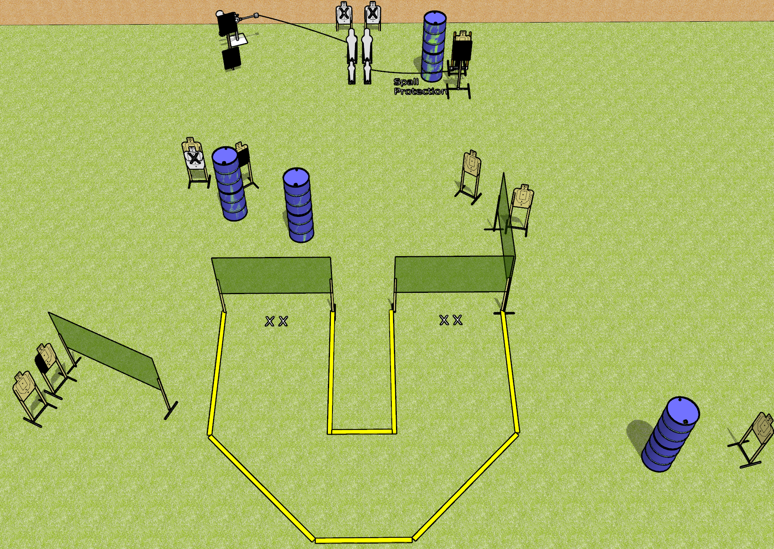
 | Dothan Gun Club – USPSA Match Footwork Course Designer : Drew Coleman
Round Count 22 rounds 8 USPSA targets 2 pepper poppers, 2 mini poppers, 2 falling plates
Equipment List 7 wall feet 3 18x24 plates + stands 1 bobber Red stitch swinger 2 medium fault lines 1 50%, 1 left HC

Slide 10
Footwork
Written Stage Briefing
Footwork is a 22 round, 110 point, Comstock course of fire. There are 8 USPSA targets, 2 pepper poppers, 2 mini poppers, and 2 falling plates. The best 2 hits on paper will score, and steel must fall to score. The start signal is audible.
The swinging steel target is activated by the left pepper popper. The bobber is activated by the right mini popper. Please check the activators prior to walkthrough and set them the same way every time.
Handgun start position is both feet on either set of X’s, wrists below belt. Handgun is loaded and holstered.
PCC start position is both feet on either set of X’s. Loaded carbine is held with both hands, stock on belt, safety on.
On start signal, engage targets from within the shooting area.

Slide 11
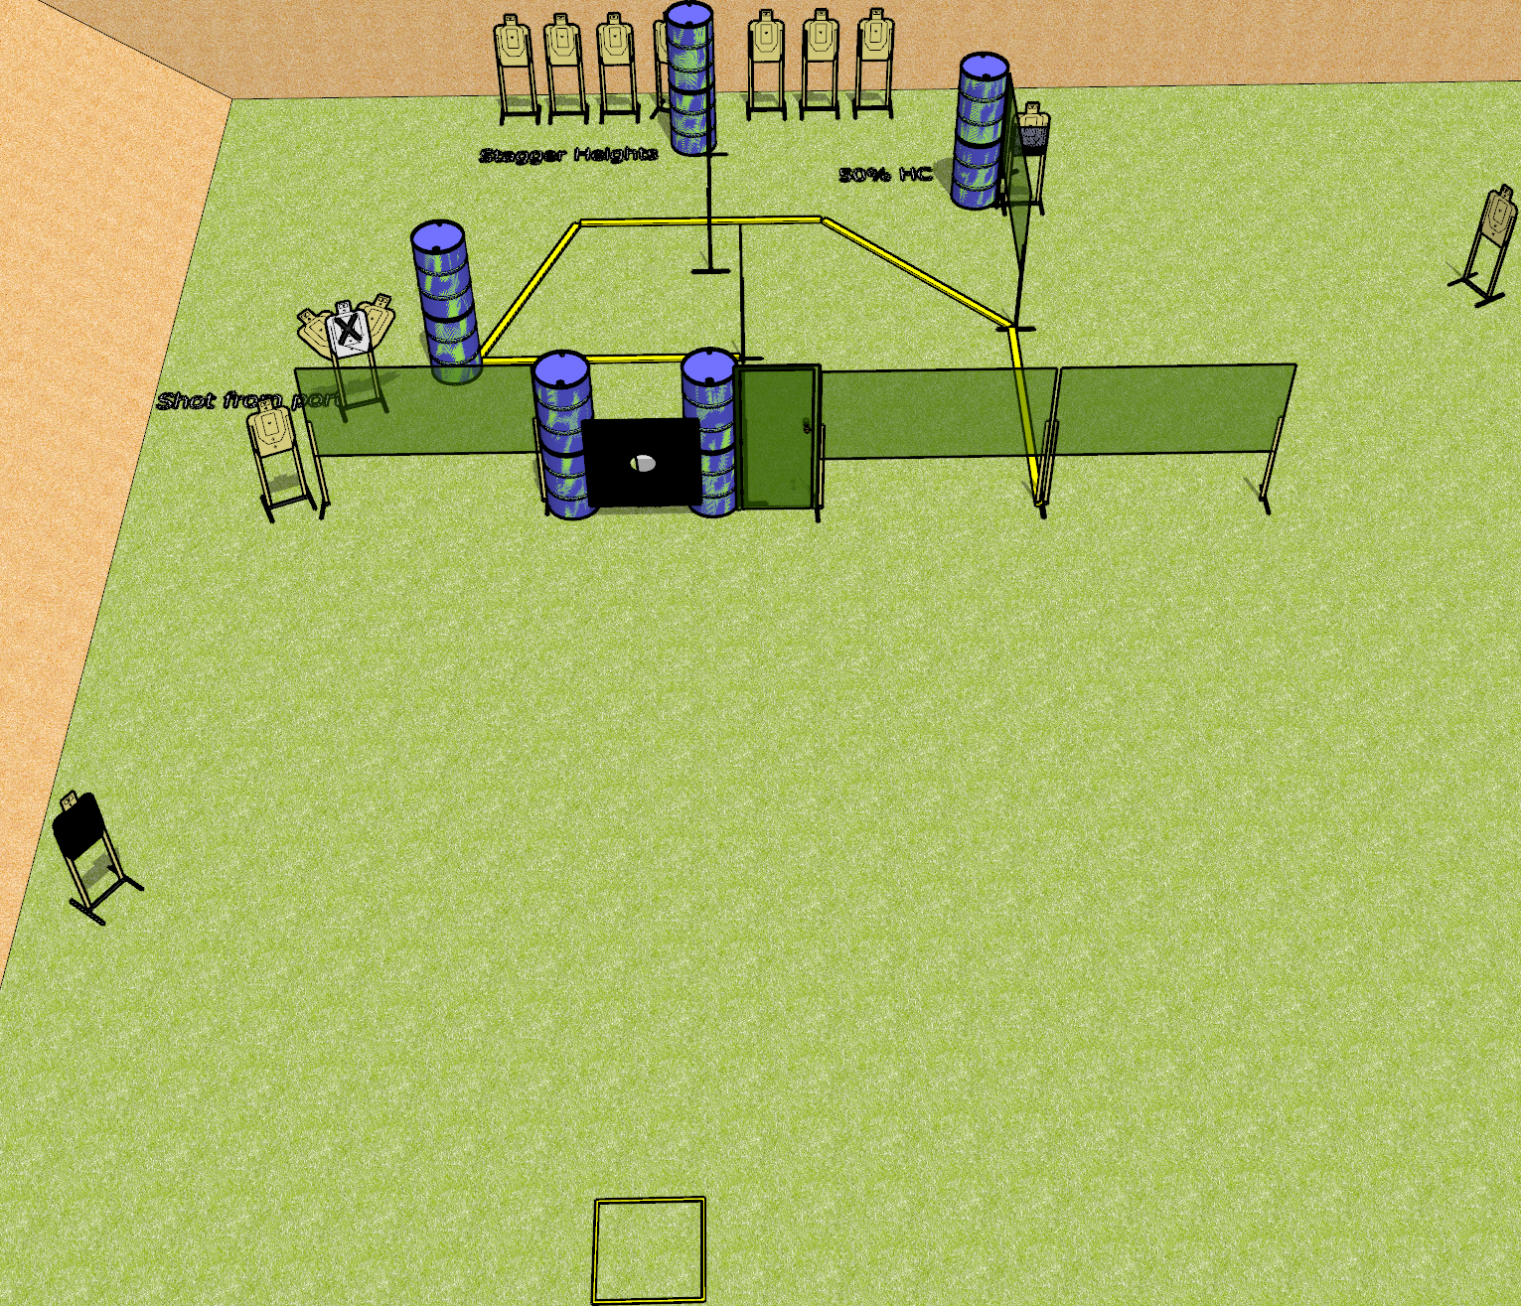
 | Dothan Gun Club – USPSA Match Door Kicker Course Designer : Drew Coleman
Round Count 29 rounds 14 USPSA targets 1 pepper popper
Equipment List 11 wall feet Big plate with hole in it + 2 stands Door 2 50%, 1 headshot NOTE: targets with NS on the left should be angled to port.
Port

Slide 12
Door Kicker
Written Stage Briefing
Door Kicker is a 23 round, 115 point, Comstock course of fire. There are 12 USPSA targets and 1 pepper popper. The best 2 hits on paper will score, and steel must fall to score. The start signal is audible.
The door is “locked” with an activator that is activated by the pepper popper. Please check the activator prior to walkthrough and set it the same way every time.
Handgun start position is in start box, wrists below belt. Handgun is loaded and holstered.
PCC start position is in start box. Loaded carbine is held with both hands, stock on belt, safety on.
On start signal engage targets as they become available from within the shooting area.

Slide 13
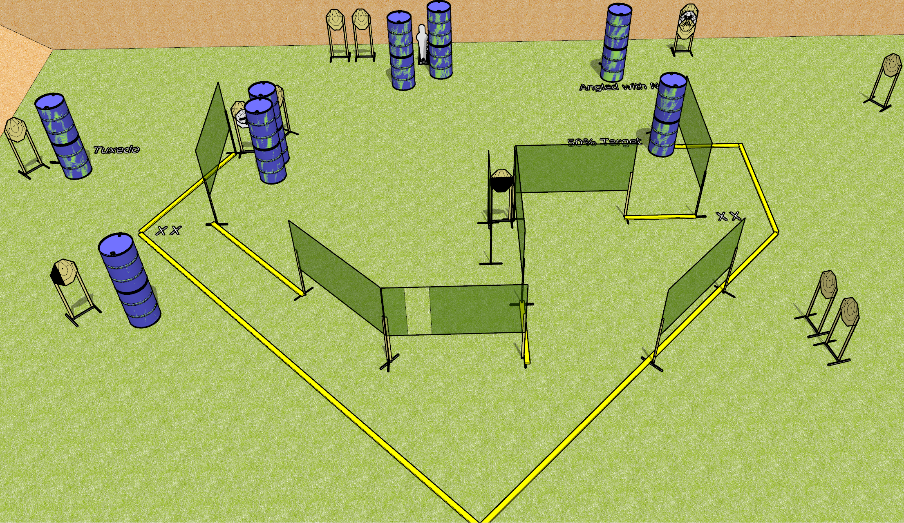
 | Dothan Gun Club – USPSA Match Flights of Fancy Course Designer : Drew Coleman
Round Count 31 15 ISPC 1 Pepper popper
Equipment List 3 medium fault lines 15 wall feet 1 left, 2 50% HC, 1 tuxedo

Slide 14
Flights of Fancy
Written Stage Briefing
Flights of Fancy is a 31 round, 155 point, Comstock field course. There are 15 IPSC targets and 1 pepper popper. The best 2 hits on paper will score, and steel must fall to score. The start signal is audible.
Handgun start position is both feet on either set of X’s, wrists below belt. Handgun is loaded and holstered.
PCC start position is both feet on either set of X’s. Loaded carbine is held with both hands, stock on belt, safety on.
On start signal, engage targets as they become available from within the shooting area.

Slide 15
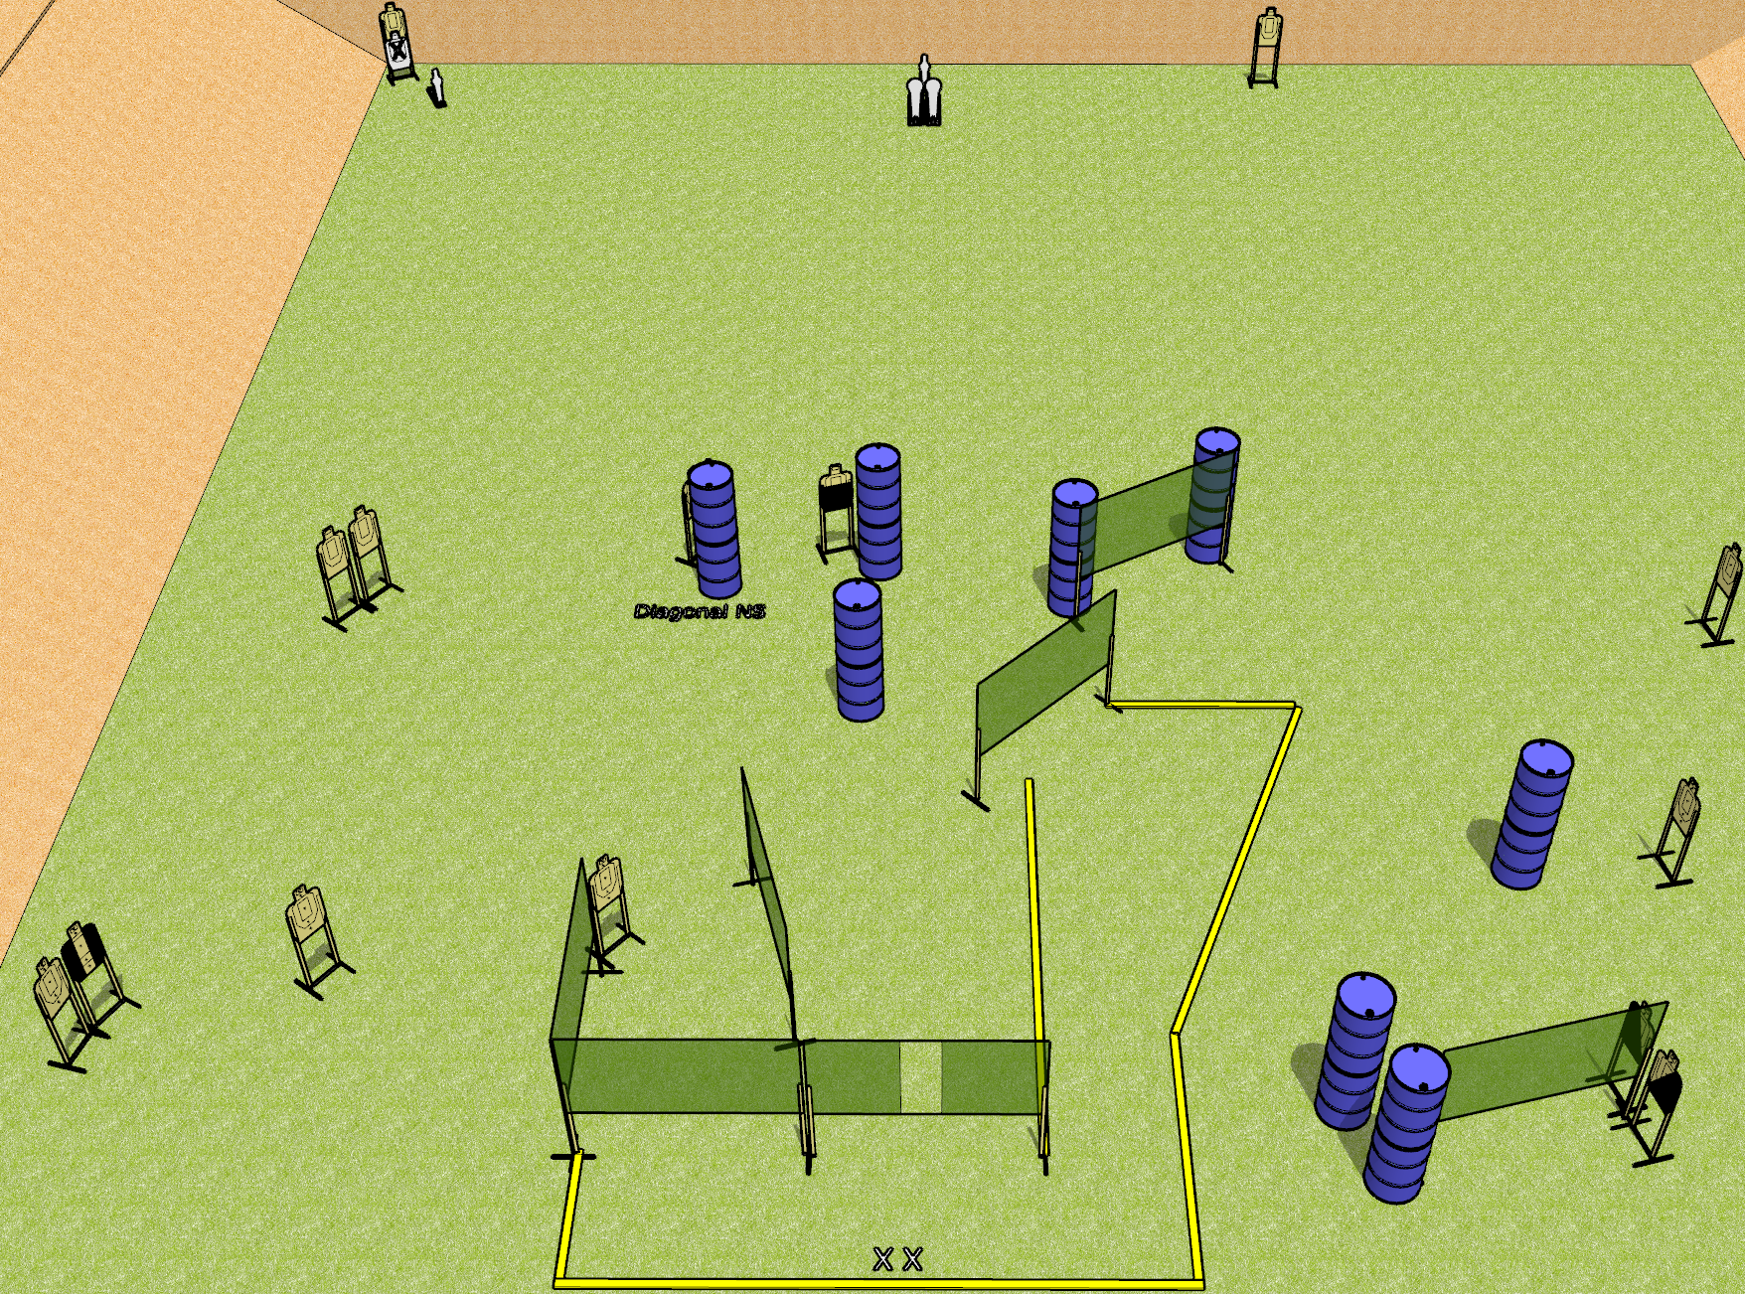
 | Dothan Gun Club – USPSA Match Mom’s Spaghetti Course Designer : Drew Coleman
Round Count 32 rounds 14 USPSA targets 2 colt poppers, 2 USPSA mini poppers
Equipment List 12 wall feet 1 Tuxedos, 1 left diagonal, 1 right diagonal, 1 50%

Slide 16
Mom’s Spaghetti
Written Stage Briefing
Mom’s Spaghetti is a 32 round, 160 point, Comstock field course. There are 14 USPSA targets, 2 colt poppers, and 2 mini poppers. The best 2 hits on paper will score, and steel must fall to score. The start signal is audible.
Handgun start position is both feet on X’s, wrists below belt. Handgun is loaded and holstered.
PCC start position is both feet on X’s. Loaded carbine is held with both hands, stock on belt, safety on.
On start signal, engage targets as they become available from within the shooting area.

Slide 17
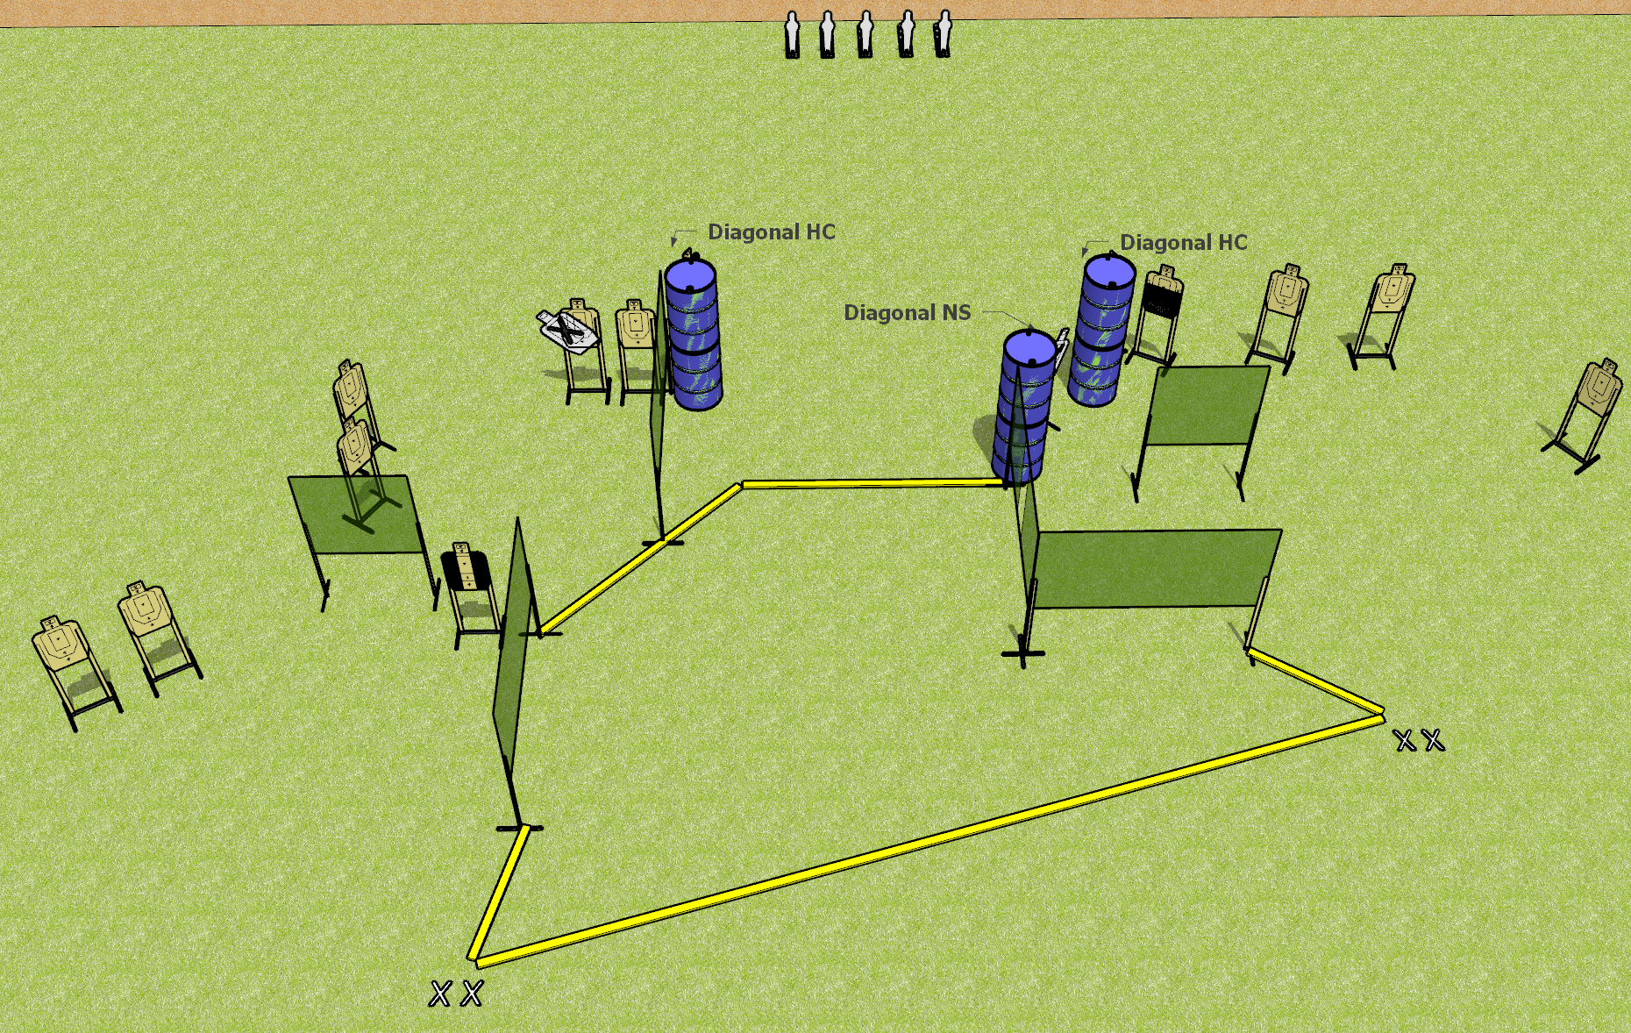
 | Dothan Gun Club – USPSA Match Fun in the Sun Course Designer : Drew Coleman
Round Count 33 rounds 14 USPSA targets 5 USPSA mini poppers
Equipment List 11 wall feet 1 tuxedo, 1 left diagonal and 1 right diagonal, 1 50% 2 medium fault lines

Slide 18
Fun in the Sun
Written Stage Briefing
Fun in the Sun is a 33 round, 165 point, Comstock field course. There are 14 USPSA targets and 5 USPSA mini poppers. The best 2 hits on paper will score, and steel must fall to score. The start signal is audible.
Handgun start position is both feet on either set of X’s, wrists below belt. Handgun is loaded and holstered.
PCC start position is both feet on either set of X’s. Loaded carbine is held with both hands, stock on belt, safety on.
On start signal, engage targets as they become available from within the shooting area.

Slide 19
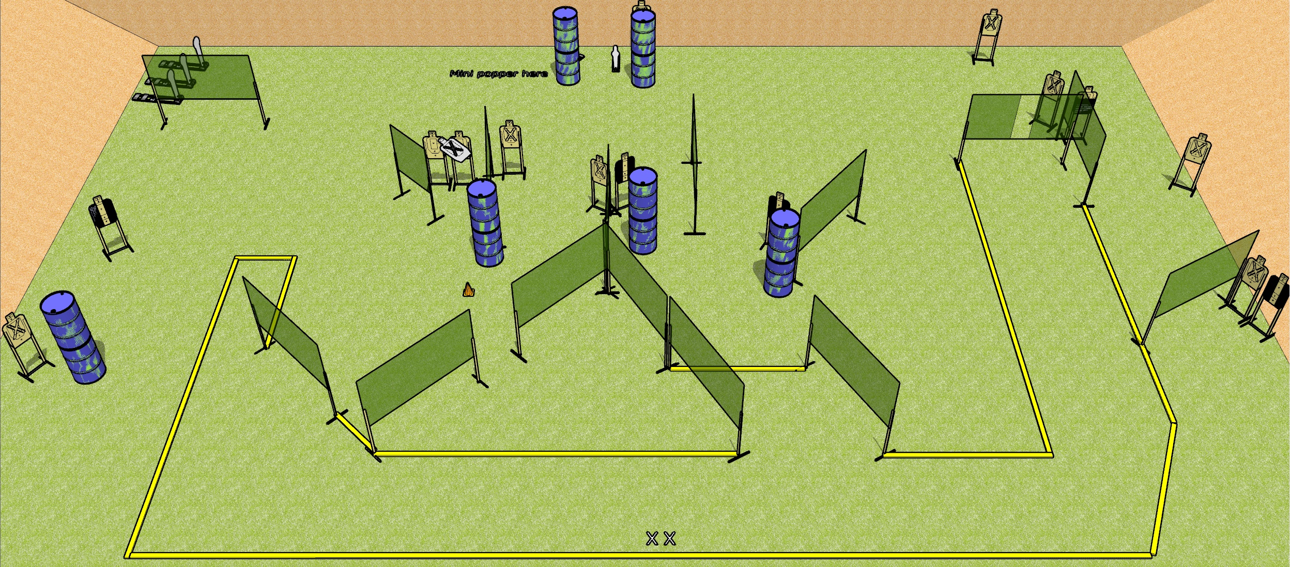
 | Dothan Gun Club – USPSA Match Bring Your A-Game Course Designer : Drew Coleman
Round Count 35 rounds 15 USPSA targets 3 colt poppers, 2 USPSA mini poppers
Equipment List 28 wall feet 4 tuxedos, 1 50% Setup Note: there’s a mini behind the left set of barrels by the berm, and a paper target behind the other set to the right.

Slide 20
Bring Your A-Game
Written Stage Briefing
Bring Your A-Game is a 35 round, 175 point, Comstock field course. There are 15 USPSA targets, 3 colt poppers, and 2 USPSA mini poppers. The best two hits on paper will score, and steel must fall to score.
Handgun start position is both feet on X’s, wrists below belt. Handgun is loaded and holstered.
PCC start position is both feet on X’s. Loaded carbine is held with both hands, stock on belt, safety on.
On start signal, engage targets as they become available from within the shooting area.

